Slide 1


GAME SALES PRESENTATION
Syed Abid Hassan

Slide 2
TABLE OF CONTENTS
01
03
02
04
Overview
Game Years
It contains the chunks of insights from the analysis.
It shows which years have the most games published.
Game Ranking by User Score
Games Shipped by Year
It shows the game ranking w.r.t their user score.
It shows which years have the most games shipped.

Slide 3
“What doesn't kill me, gives me EXP.”

Slide 4
01
OVERVIEW

Slide 5
🎮
★★★☆☆
★★★☆☆
Average Critic Score
Average User Score
Total Games
7.48/10
7.0/10
2208

Slide 6

02
GAME RANKING

Slide 7

TOP 4 GAMES BY USER SCORE
1st
2nd
3rd
4th
DRAGON BALL FIGHTERZ
METAL GEAR SOLID HD
CHILD OF LIGHT
LITTLE NIGHTMARES

Slide 8

LIFE IS MORE FUN IF YOU PLAY GAMES!

Slide 9
03
GAME PUBLISHING YEARS

Slide 10
TOP 4 GAME PUBLIHSING YEARS
1st
2nd
3rd
4th
2018
2017
2016
2015
361 Games Published
354 Games Published
295 Games Published
255 Games Published

Slide 11
04
GAMES SHIPPED

Slide 12
TOP 6 GAME SHIPPING YEARS
2017
2014
2015
282M Games Shipped
253M Games Shipped
240M Games Shipped
2016
2018
2013
234M Games Shipped
213M Games Shipped
175M Games Shipped

Slide 13
WORLD RANKING
1st
2nd
USA
CHINA
Revenue:46.4B
Revenue: 44.0B
3rd
4th
JAPAN
SOUTH KOREA
Revenue: 19.1B
Revenue: 7.4B

Slide 14
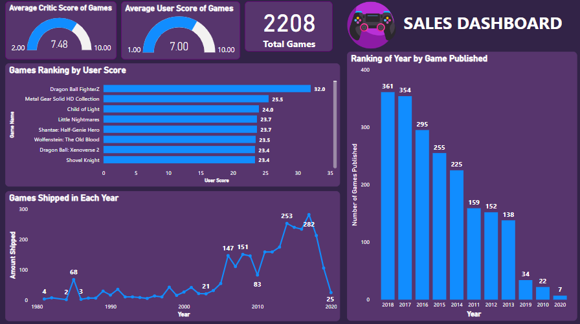
DASHBOARD

Slide 15

THANKS!

